Slide 1
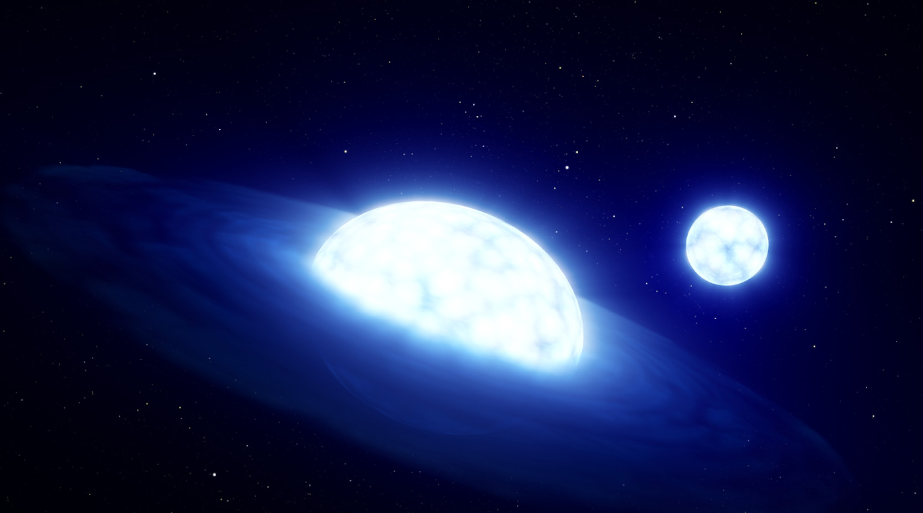




Be Stars: Lambda Pavonis
Sola Nov${\text{a}}^{1}$, Dr. Jonathan Labadie-Bart${\text{s}}^{2}$, Clarissa Pava${\text{o}}^{1}$, Randy Loberge${\text{r}}^{1}$
Mentor: Dr. Richardso${\text{n}}^{1}$
$^{1}$Embry-Riddle Aeronautical University
College of Arts and Sciences
Department of Physics
$^{2}$Paris Observatory
Notes:
Hello everyone, my name is Sola Nova, and today, I’m here to tell you about the Be star Lambda Pavonis. Before we begin, I want to thank my Mentor, Dr. Richardson for guiding me through the research process, and Dr. Labadie-Barts, a colleague of Dr. Richardson’s who provided code for Fourier Analysis and some of the data I worked with. I also want to thank a former ERAU student, Clarissa, who helped with some analysis and normalization, and Randy, an upperclassmen who helped with some code for Time Series Analysis.

Slide 2
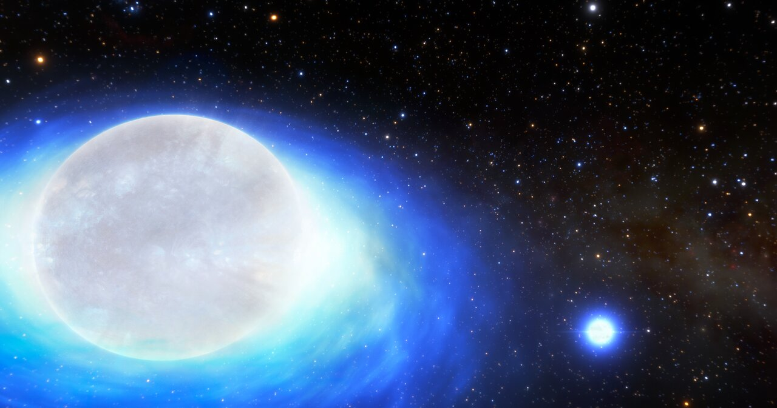

Be Stars
[1]
[3]
Spectral Class
[2]
Lambda Pavonis: B2 IIIe
Emission Lines Present
Oblate Shape
Disk
?
[1] Th., R., A. C., C., & C., M. (2013, October 15). Classical be stars: Rapidly Rotating B Stars with Viscous Keplerian Decretion Disks. arXiv.org
[2] Haiqi, C., Adela, R., Jorge, S., & Yoji, K. (1989, December 15). Analysis of the velocity law in the wind of the be star Lambda Pavonis. NASA/ADS
[3] Ghoreyshi, M. R., Carciofi, A. C., & Rímulo, L. R. (2018, June 18). The life cycles of Be viscous decretion discs: The case of ω CMa. Academic.oup.com.
Notes:
Be stars are spectral class B stars, with emission lines present. They also rotate at about 75% of critical or higher, so they have an oblate shape. And, sometimes, you’ll find a disk around the star. Lambda Pavonis is spectral type B2 IIIe. The 2 means it’s on the hotter end of B class stars, though it’s fairly average for Be stars specifically and the 3 means it has evolved off the main sequence and is now a giant. So, Be stars have a disk? The strange thing isn’t just that they have a disk, but that the disk comes and goes. The main question in Be star research is what causes the disk to form, and recent research says that NRP’s may be responsible. For the study of Lambda Pavonis specifically, the real issue is there is very little observational history, and we have a lot to learn in order to verify the idea that Non-Radial Pulsations are responsible for disk formation. The first thing we need to know is when are outbursts happening? It would be very useful to know when a disk is present and when it’s not. We also need to know if there is any periodicity, for instance what’s the period of disk formation? Last, are there any underlying frequencies that could be responsible for the disk? We can answer these questions with three things: Graphs showcasing spectroscopic changes, Time Series Analysis (TSA), and Fourier Analysis.

Slide 3
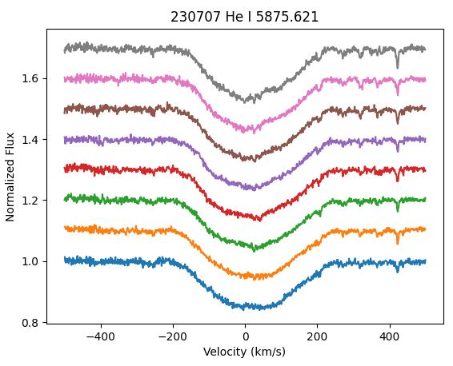
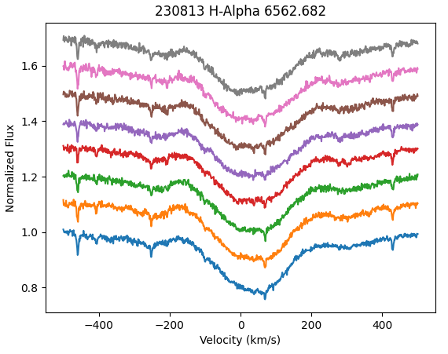
Methods - Spectra
Notes:
Rather than show you the specifics and code behind my analysis of the data I received, I can describe it with some graphs, which will be very useful, as they can also be used to describe the results. As of right now, the plan is to analyze CHIRON Data, NRES (Network of Robotic Echelle Spectrographs) Data, and TESS (Transiting Exoplanet Survey Satellite) Photometry, but I’ll be describing the work I completed with the CHIRON data as I’ve been working with that for the longest.
The first thing I did in my analysis was plot spectra for every night of CHIRON Data. Here are some examples, which show a select number of files from throughout the night for 2 separate nights of CHIRON Data. The information at the top tells you when the data was captured and for what line, so the left image was captured on July 7th, 2023 for the Helium I line at 5875.621 Angstroms. The y axis is the flux, or just the amount of light and on the x axis is velocity, which refers to radial velocity, so where the dip ends is at about 200 km per second which tells you that that part of the star is spinning at that speed away from the observer. Lastly, the color of the lines doesn’t mean anything, it just differentiates them. The code simply plots a handful of spectra, which are segments of the entire spectrum of light captured. This analysis mostly gives a basic idea of whether something is happening, though it’s mostly qualitative.

Slide 4
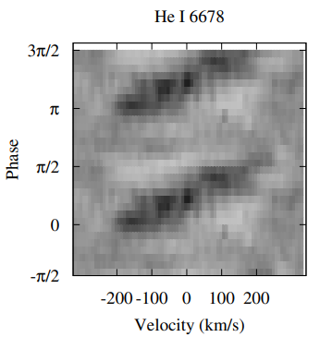
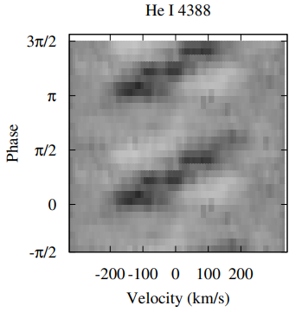
Methods - Time Series
[4]
[4]
[4] Levenhagen, R. S., Leister, N. V., & Künzel, R. (2011, January 26). Spectroscopic variabilities in λ Pavonis. NASA/ADS.
Notes:
I haven’t yet completed time series analysis, but on this slide are examples of what it produces. All spectra like the ones from the previous slide are plotted according to the phase of disk formation with the mean profile subtracted, and the result shows a sort of helical pattern that gives an idea of how the disk evolves with time. You could imagine it as the material wrapping itself around the star as the disk forms. These gray scale images are reliant on knowing the period, and that’s where Fourier analysis comes in.

Slide 5
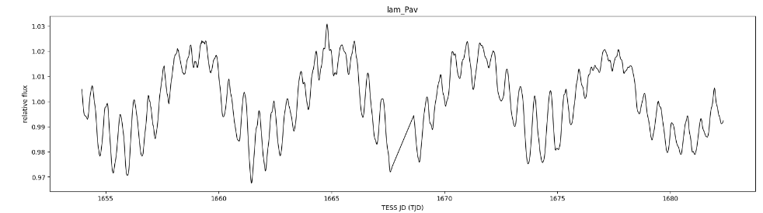
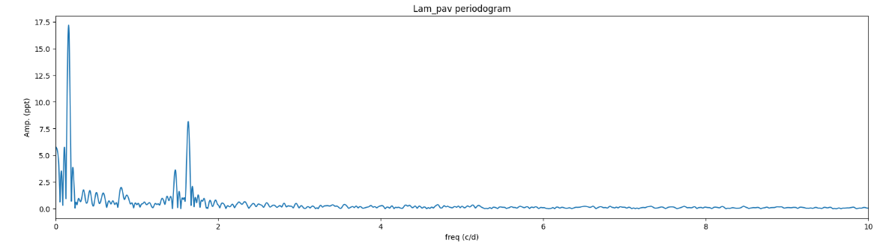
Methods- Fourier Analysis
Notes:
Fourier analysis is a little simpler in code than the spectra and Time Series. The first graph is the light curve obtained from TESS showing the light output as a function of time. Fourier analysis is using Fourier transforms to get the second graph, which display the frequencies of the star. These frequencies can be converted to periods, and then be used in the time series analysis. Up to this point, I’ve done some Fourier Analysis, that’s why I have these graphs, but all I can really tell you with these are some periods.

Slide 6
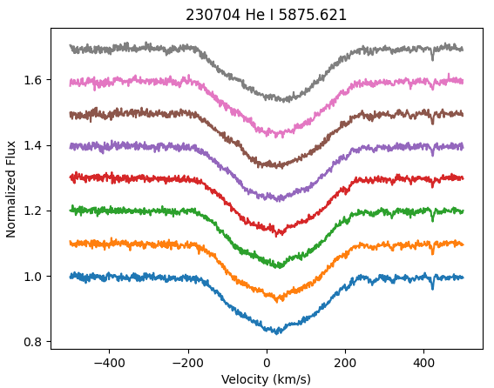
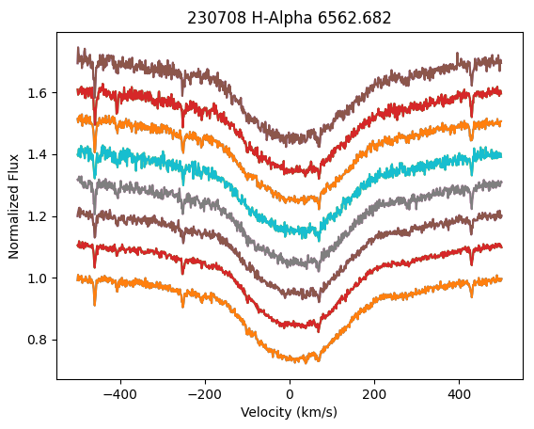
Results
Notes:
Up to this point, I’ve put together all the spectra from the CHIRON data. Let’s look at the spectra first throughout July and August of 2023. These first graphs are from early July, and these are pretty boring, in both He I and H-alpha. We’re looking for something in the wings, and the wings of these graphs are flat, so nothing is going on around the star in these images.

Slide 7
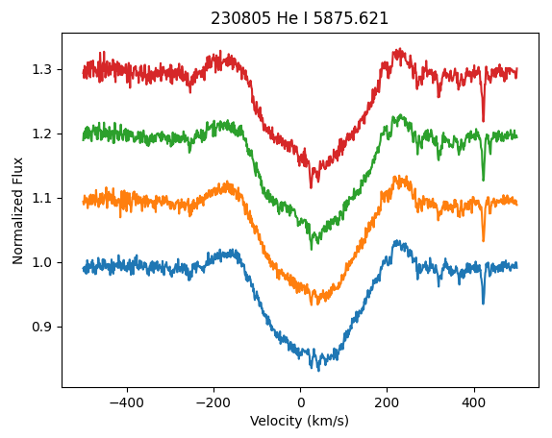
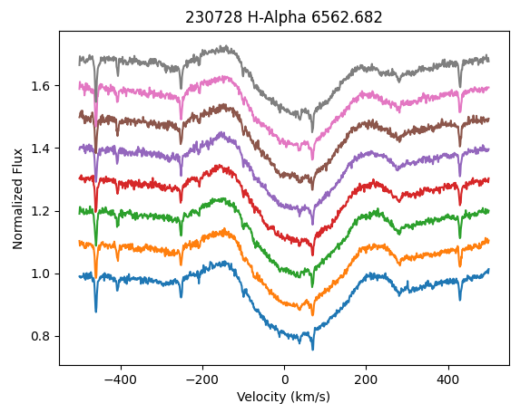
Results
Notes:
Here are the same lines being looked at, but for later July and early August, and these graphs are a little more interesting. Unlike the last ones, there are some bumps right next to the large dip, and better yet, at least in the July image, the disk evolved throughout the night. As you can see, it’s not much different, but that top line, the gray one, on the right side, is shallower than the blue line at the bottom. Let’s look at later August.

Slide 8
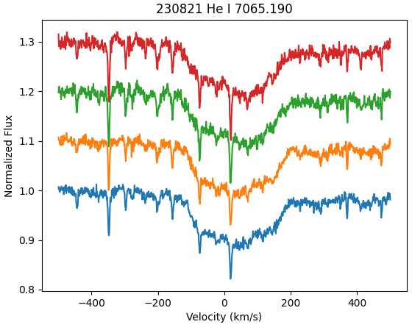
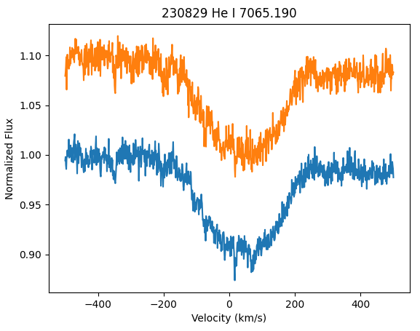
Results
Notes:
These graphs are of the same Helium line, but it’s a different one than the previous graphs, and once again the wings are flat again and there’s a week between these data, so only one outburst happened in those two months. These graphs did give us some qualitative information, but this is only a basic look at the data.

Slide 9
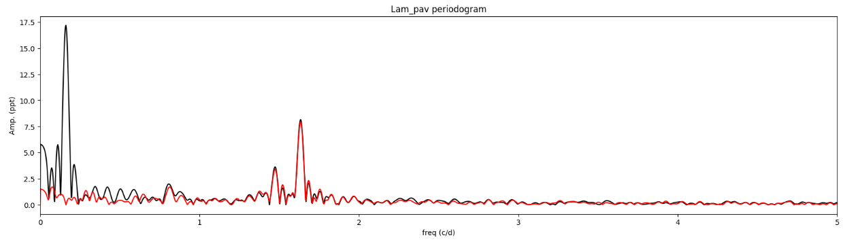
Summary
Lambda Pavonis: B2 IIIe
Notes:
In the end, we know for sure that Lambda Pavonis, a B2 IIIe star had an outburst near the end of July and the beginning of August based off these extra bits of emission around the star. We can also glean some periods from the Fourier transform. The first peak corresponds to a period around 6 days, while these two peaks would be periods a little over half a day. With period data, we can do some time series analysis to better understand what’s happening with the disk through time, but for right now, we have a very good start to understanding how disks form, at least around this star. Thank you, for listening.

